Slide 1
Trend Forecasting of
Movie Box Office & Oscar Nominations
Group A
Tianyi Deng, Biran Li, Jiyang Liu, Yu-lin Shih

Slide 2
Agenda
Hardware & Tools
Data Size and Sources
Movie Box Office Forecast
Oscar Nominations Forecast
Conclusion & Observations

Slide 3
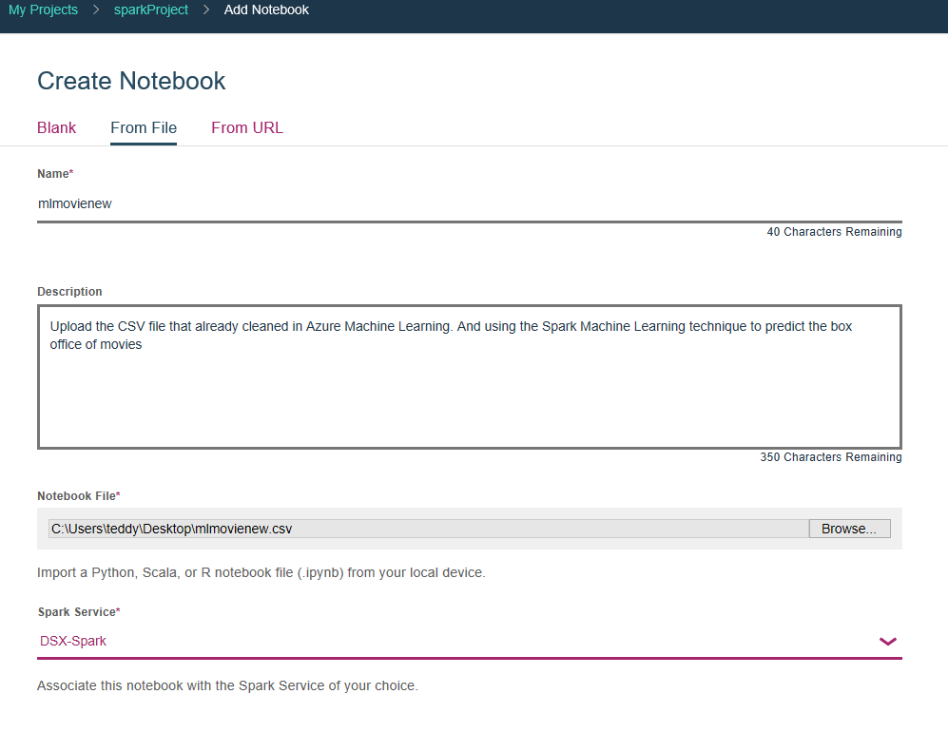
Hardware
Databricks File System
Spark 2.1 Scala 2.10
Memory - 6GB
IBM data science experience

Slide 4
Tools
Azure Machine Learning
IBM Data Science Experiences
DataBricks
Jupyter(python)
Spark(python)
Github

Slide 5
Data Size: 510 MB
Data Source:
GroupLens Research for Movielens Lab Dataset: https://grouplens.org/datasets/movielens/
IMDB 5000 Movie Dataset:
https://www.kaggle.com/deepmatrix/imdb-5000-movie-dataset
The Academy Awards(1927-2015) Dataset:
https://www.kaggle.com/theacademy/academy-awards
Notes:
Rating data sets from the MovieLens web site: contains 20 million ratings and 465,000 tag applications applied to 27,000 movies by 138,000 users.
28 variables for 5043 movies , spanning across 100 years in 66 countries
The official record of past Academy Award winners and nominees from 1927 -2015

Slide 6
Movie Box Office Forecast
Model
Linear Regression(LR)
Gradient boost regression(GBT)
Platform
Jupyter Notebook
AzureML, Databricks, IBM

Slide 7
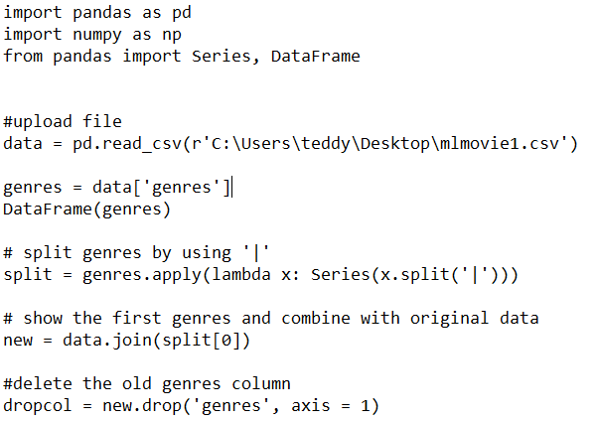
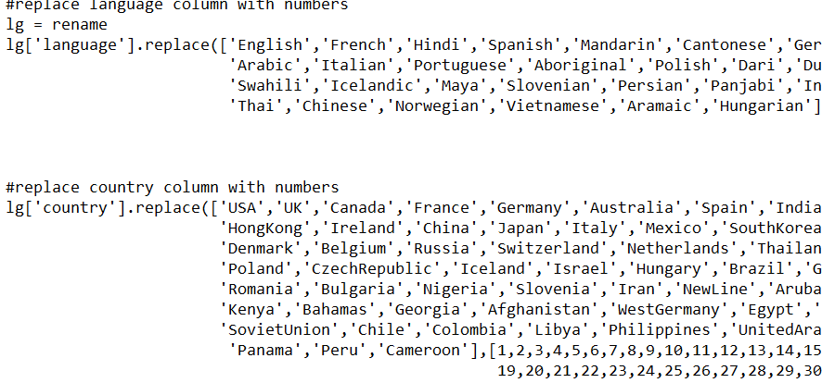
Data preparation
Jupyter Notebook
Replace column from word to integer
Change and add columns

Slide 8
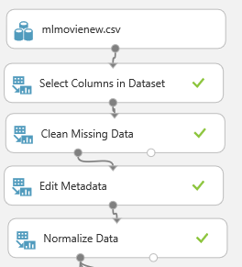
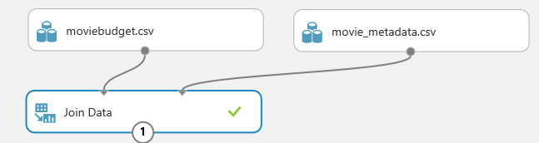
Data preparation AzureML
Upload file to AzureML
Join Data

Slide 9
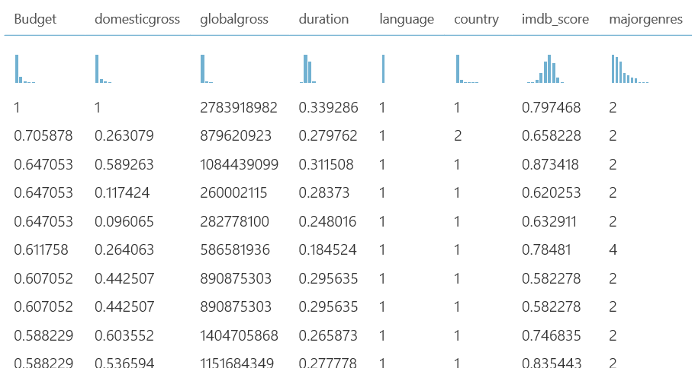
New CSV file

Slide 10
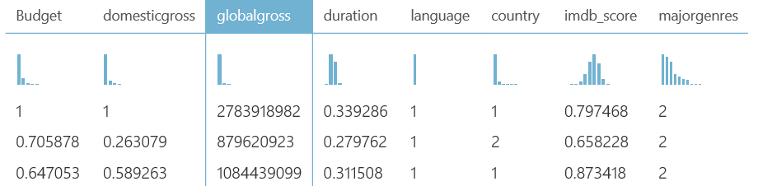


Data Understanding
Target column: globalgross
min/max: $423/$2,783,918,982
Numeric attributes: “budget, domesticgross, globalgross, duration, imdb_score”
Categorical attributes: “language, country, majorgenres”

Slide 11
AzureML - Regression
Algorithms: Linear Regression, Gradient Boost Regression
Split: 0.7/0.3
Coefficient of Determination: 90.6%

Slide 12
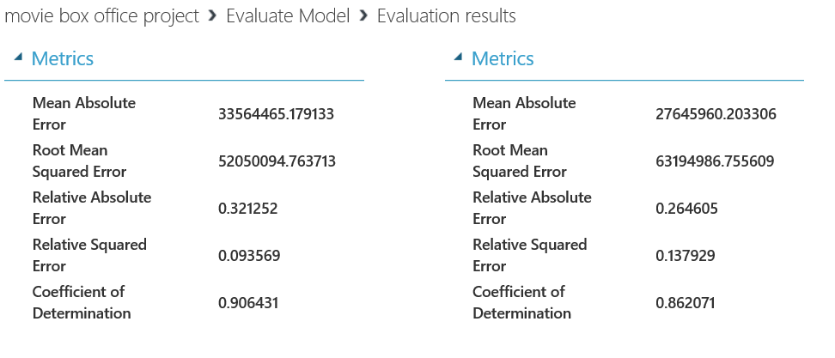
AzureML - Evaluation
Linear Regression
Gradient Boosted Regression

Slide 13
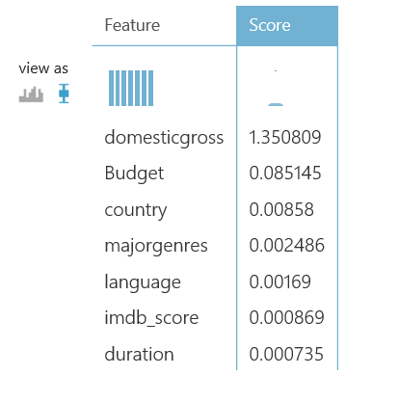
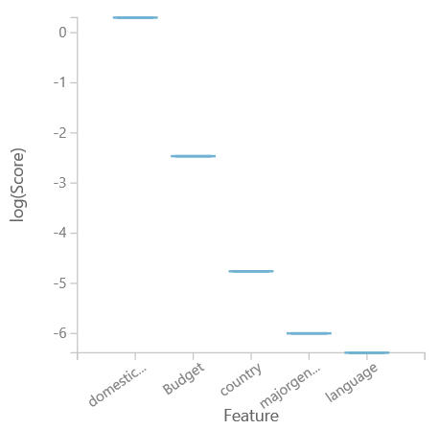
Importance scores of feature variables

Slide 14
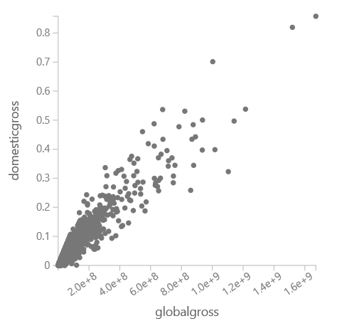
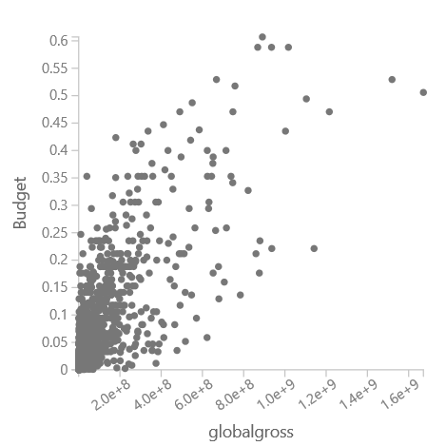
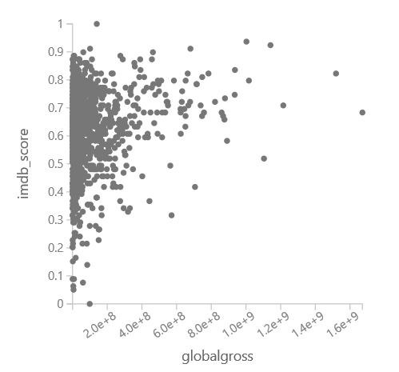
Importance scores of feature variables cont.
Global Gross vs. Domestic Gross
Global Gross vs. Budget
Global Gross vs. Movie Rating

Slide 15
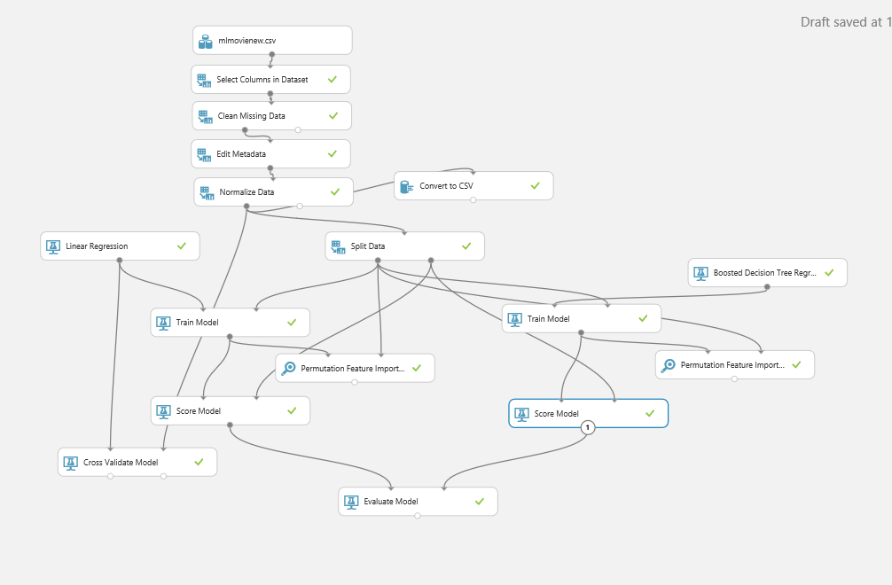
Azure ML - Mapping

Slide 16
Spark Machine Learning
IBM: Linear Regression
DATABRICKS: Gradient Boosted Trees Regression

Slide 17
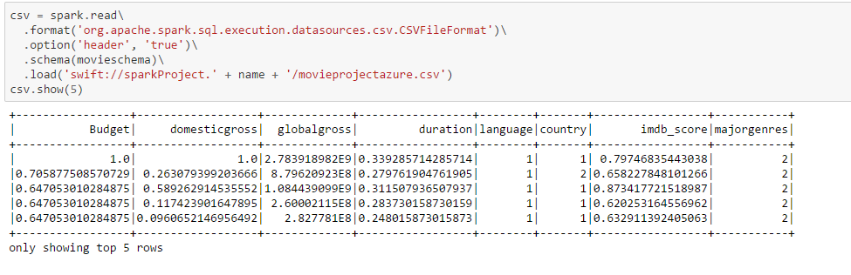
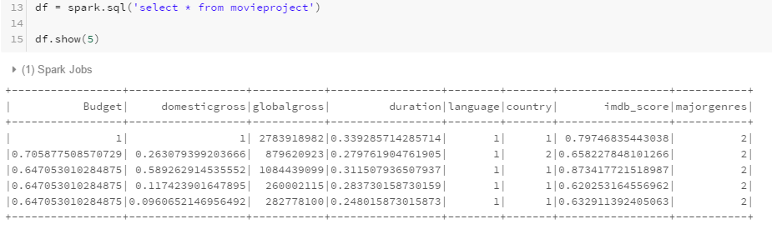
Spark ML(Load & Prepare Data)

Slide 18

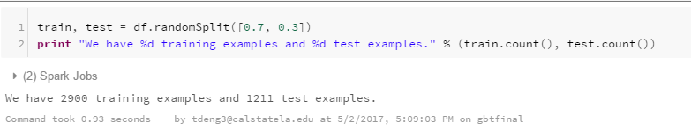
Spark ML(Split Data)
Linear Regression in IBM
GBT in Databricks

Slide 19
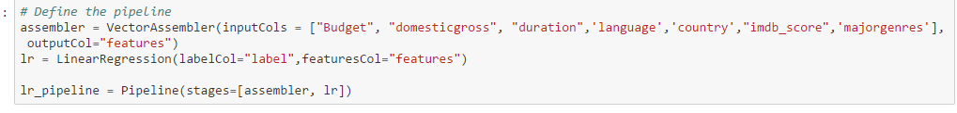
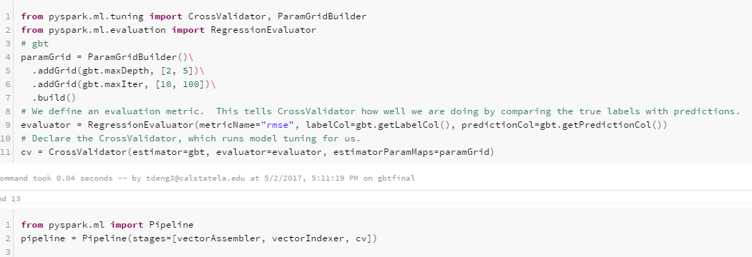
Spark ML(Pipeline)
Linear Regression in IBM
GBT in Databricks

Slide 20
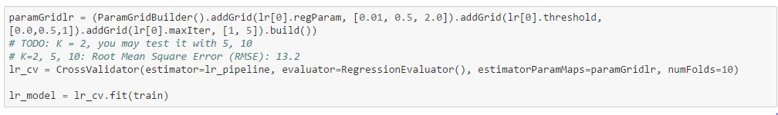
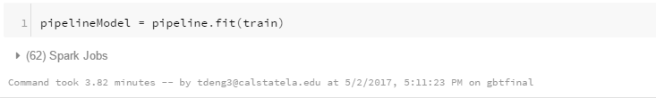
Spark ML(Train)
Linear Regression in IBM
GBT in Databricks

Slide 21
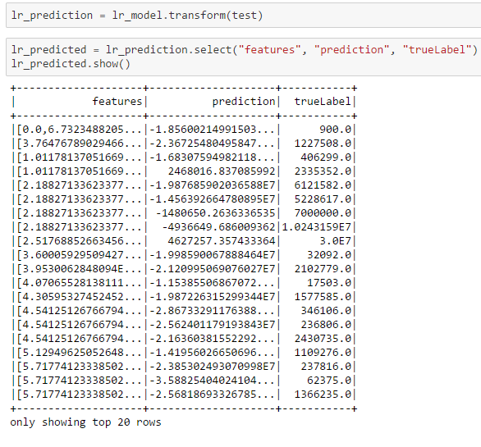
Sprak ML(Test - Linear Regression)

Slide 22
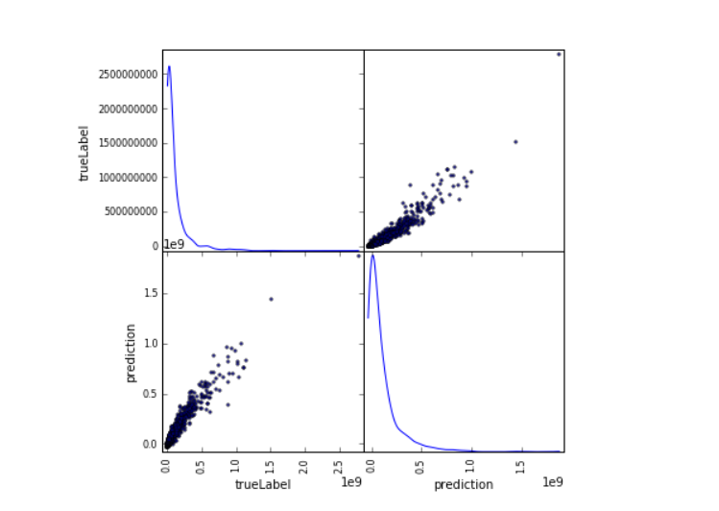
Sprak ML(Test - Linear Regression)

Slide 23
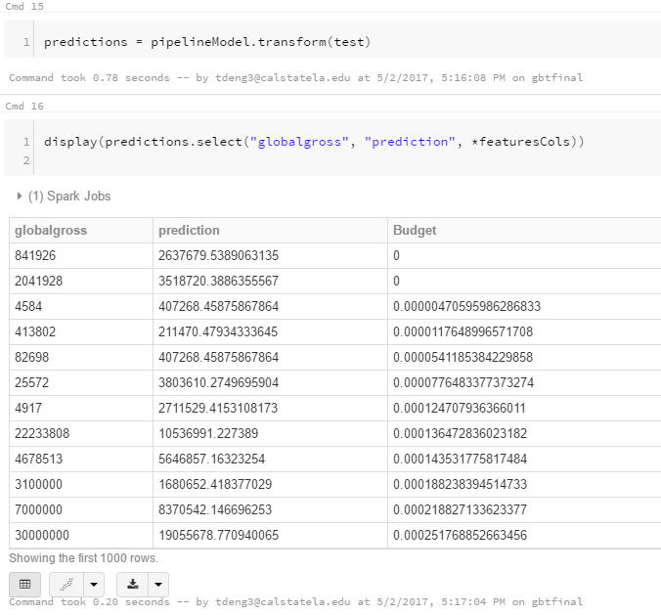
Sprak ML(Test - GBT Regression)

Slide 24
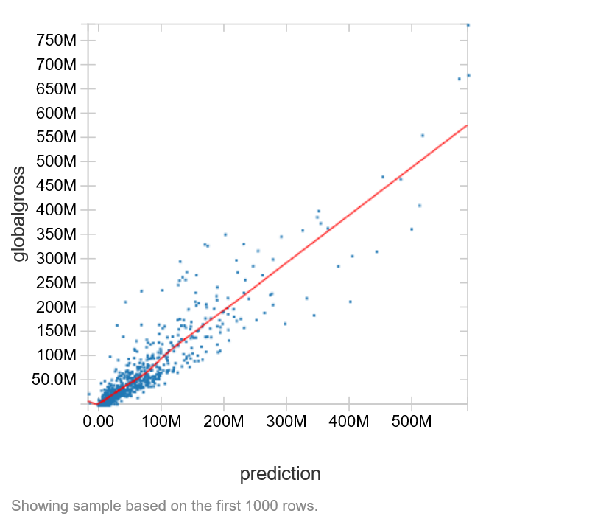
Sprak ML(Test - GBT Regression)

Slide 25

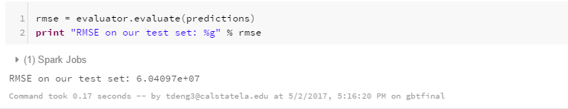
Spark ML (RMSE)
Linear Regression in IBM
GBT in Databricks

Slide 26
AzureML vs SparkML
RMSE | AzureML | SparkML
Linear Regression | 52,050,094.7637 | 57,188,471.1788
GBT Regression | 63,194,986.7556 | 60,409,700.0000

Slide 27
Oscar Best Picture Forecast
Classification
Logistic Regression
Decision Tree

Slide 28
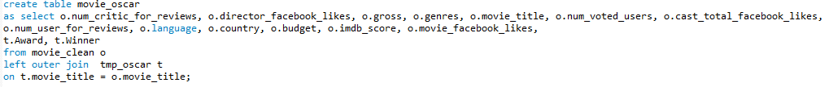
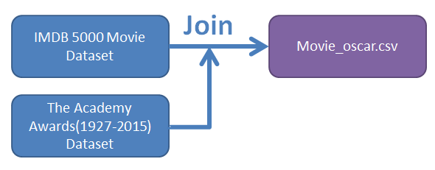
Data preparation

Slide 29

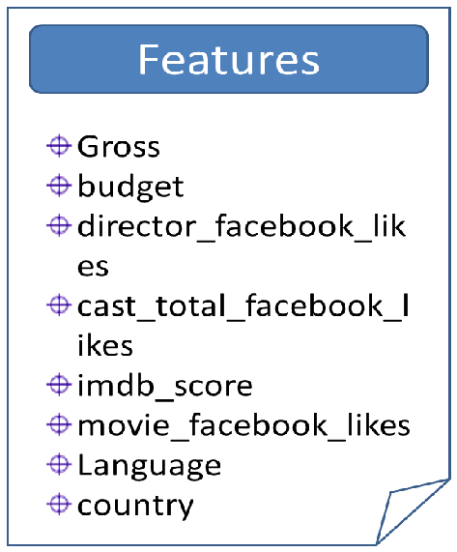
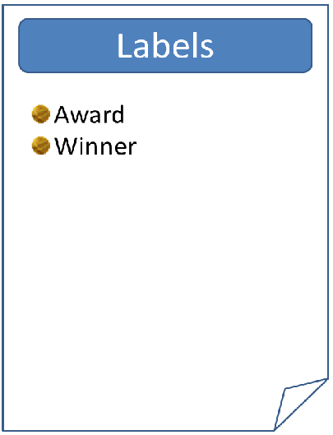
Preprocessed data

Slide 30
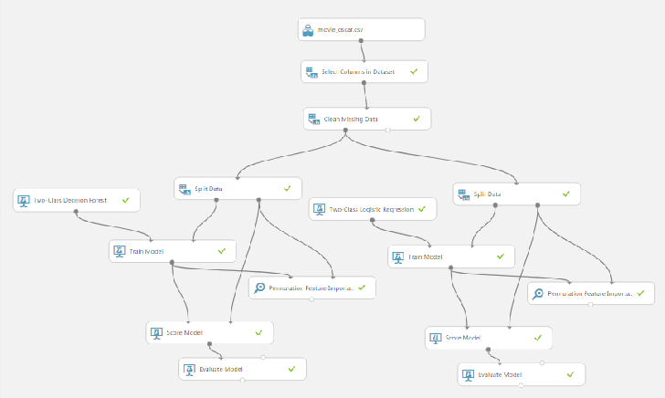

Azure(Mapping)

Slide 31
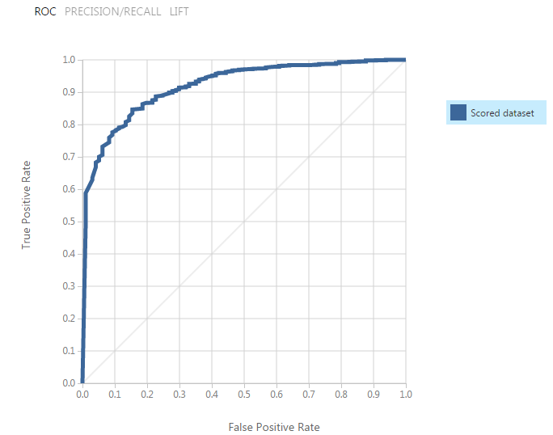
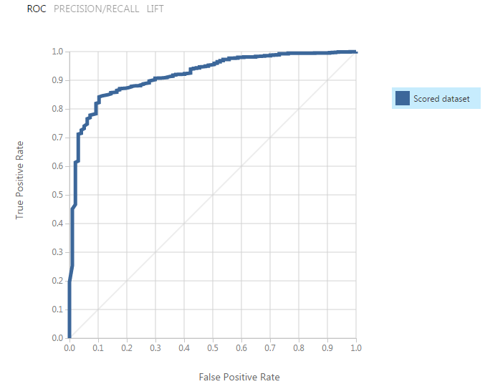
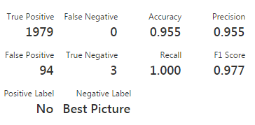
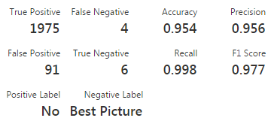
Azure(Evaluate)
Two-Class Decision Forest
Two-Class Logistic Regression

Slide 32
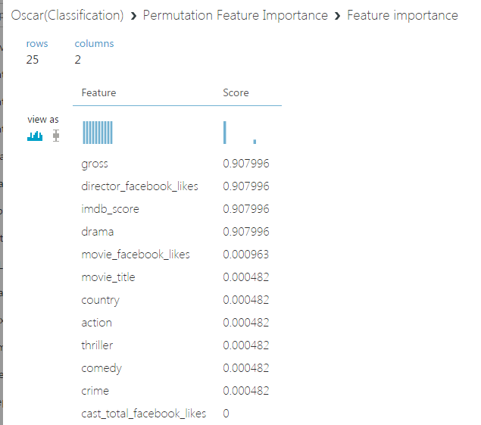
Azure(Score)

Slide 33
Preprocessed data
Features
Gross
IMDB_score
Director_facebook_likes

Slide 34
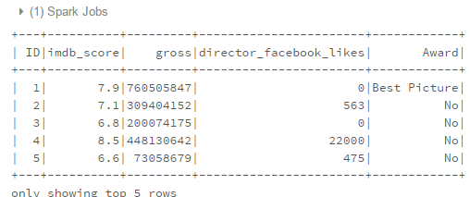
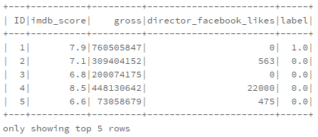
Databricks(Load & Prepare Data)

Slide 35
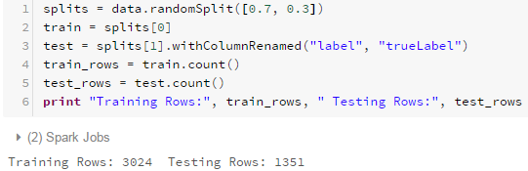
Databricks(Split Data)

Slide 36
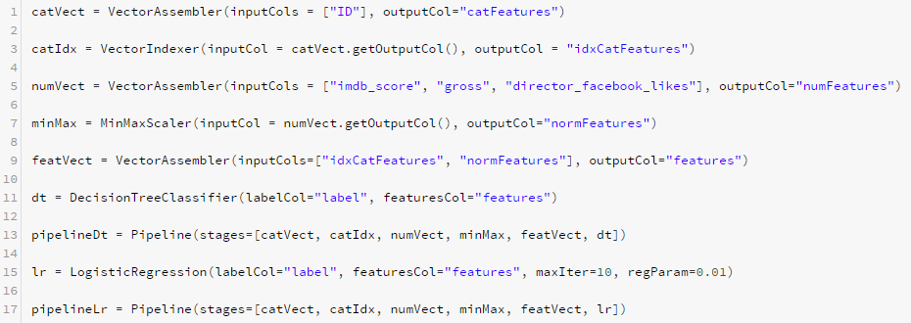
Databricks(Pipeline)

Slide 37
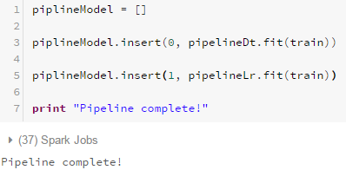
Databricks(Train)

Slide 38
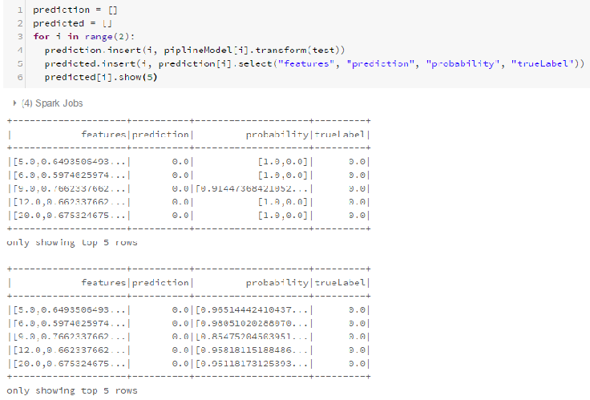
Databricks(Train & Test)

Slide 39
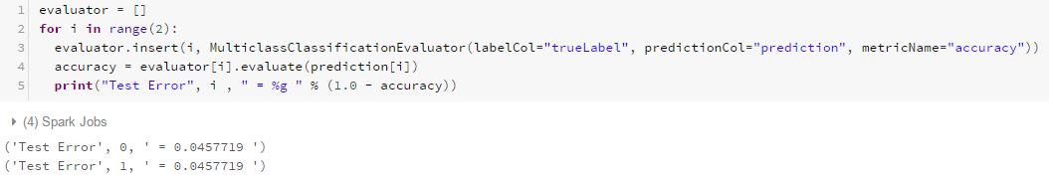
Databricks(Accuracy)

Slide 40
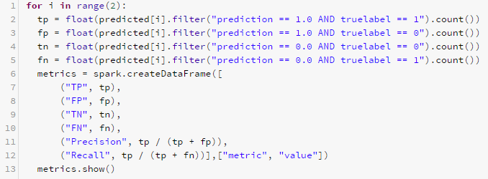
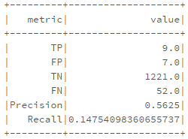
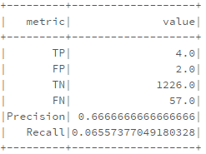
Databricks(ROC)

Slide 41
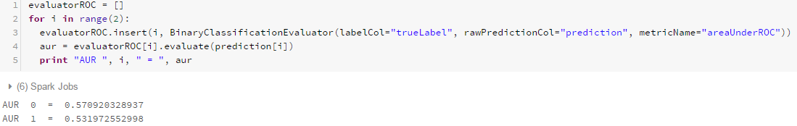
Databricks(ROC)

Slide 42
Azure vs Spark
ROC | Azure | Databricks
Decision Tree
Logistic Regression

Slide 43
Conclusion
Movie Box Office
Linear regression is better as it has lower RMSE
Oscar Nominations
both models produced similar precision and accuracy rate

Slide 44
Observation
Azure is better for cleaning missing data, has many built-in graphics, and is easier to use.
Spark(DB and IBM) is better for advanced graphics.
Databricks has faster processing time.
IBM provides detailed error log.

Slide 45
Github Link
https://github.com/biranlicis/Movie-Box-Office-Machine-Learning

Slide 46
References
Microsoft DAT202.3x Implementing Predictive Analytics with Spark in Azure HDInsight
Microsoft's DAT203x, Data Science and Machine Learning Essentials
Gautam, Geetika, and Divakar Yadav. Sentiment Analysis of Twitter Data Using Machine Learning Approaches and Semantic Analysis - IEEE Xplore Document. N.p., n.d. Web. 02 May 2017.
"MovieLens." GroupLens. N.p., 18 Oct. 2016. Web. 02 May 2017.
Concetta A., and Constanc H. McLaren. "Movie Data." Journal of Statistics Education, V17n1. N.p., 2009. Web. 02 May 2017.
Chuansun7. "IMDB 5000 Movie Dataset." IMDB 5000 Movie Dataset | Kaggle. N.p., n.d. Web. 02 May 2017.
"The Academy Awards, 1927-2015." Academy of Motion Picture Arts and Sciences, n.d. Web. 02 May 2017.

Slide 47
Thank you
Any questions?

